Slide 1
Evolution of Deep Learning Frameworks: CNNs, RNNs, LSTMs, Transformers towards LLM
Dr.V.Ajantha Devi
Research Head,

Slide 2
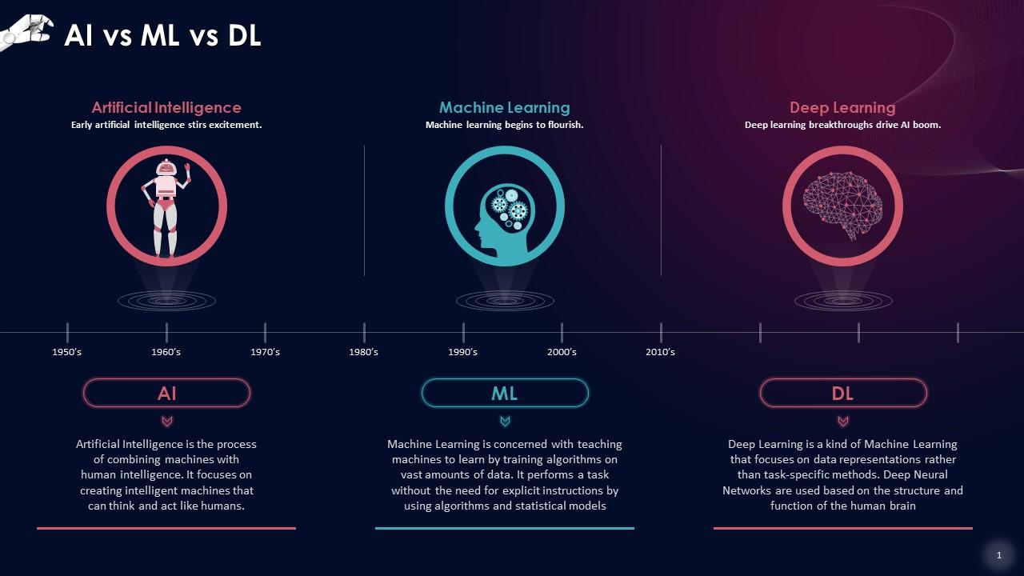

Slide 3
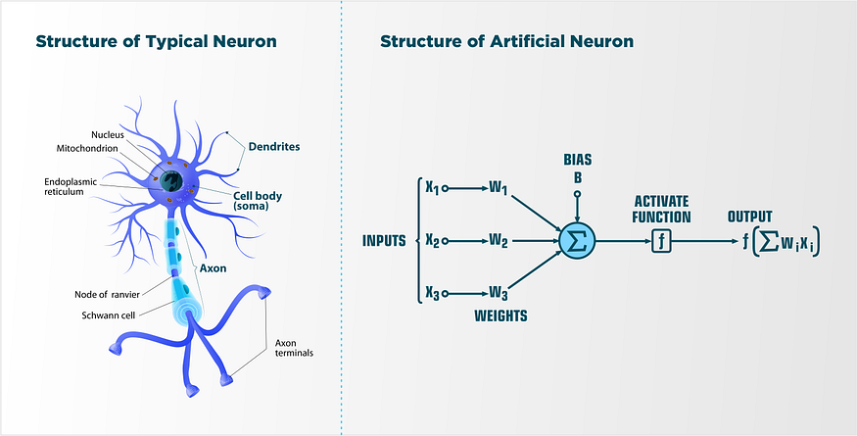
Basics: The Neuron

Slide 4
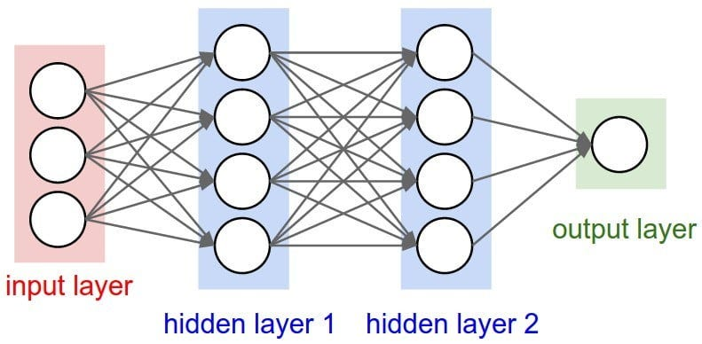
Artificial Neural Networks

Slide 5
Types of Artificial Neural Networks

Slide 6
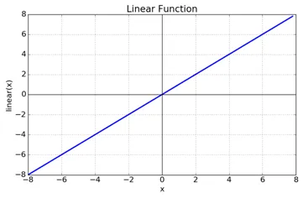
Activation Functions
Linear Activation Function
Non-linear Activation Function

Slide 7
Activation Functions

Slide 8
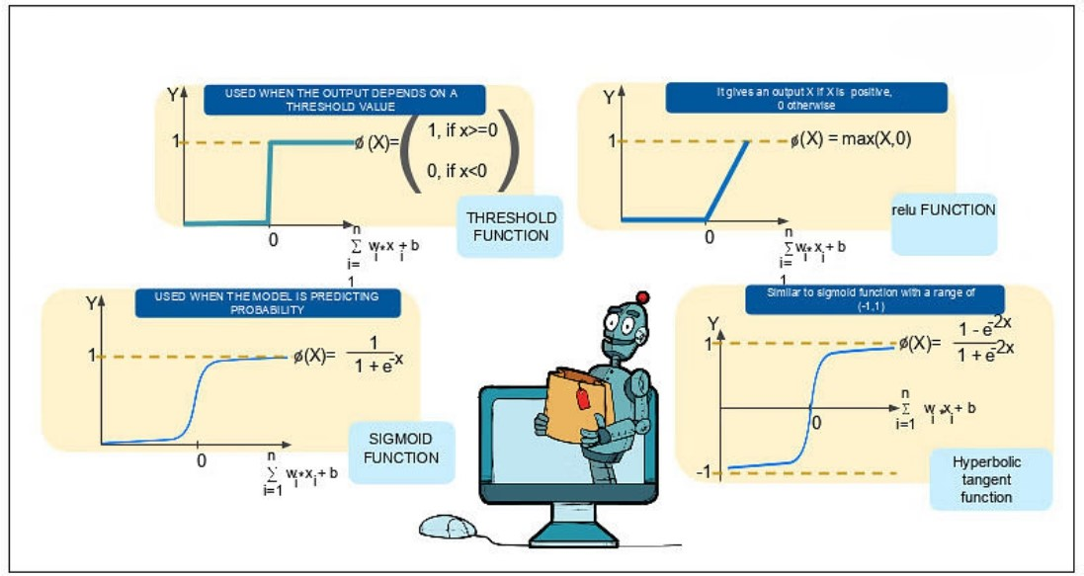
Activation Functions

Slide 9


Slide 10
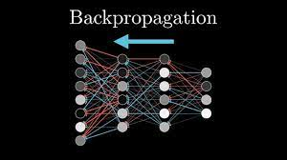
Backpropagation work

Slide 11
The Problem Space

Slide 12
Structure of Convolutional Neural Network

Slide 13
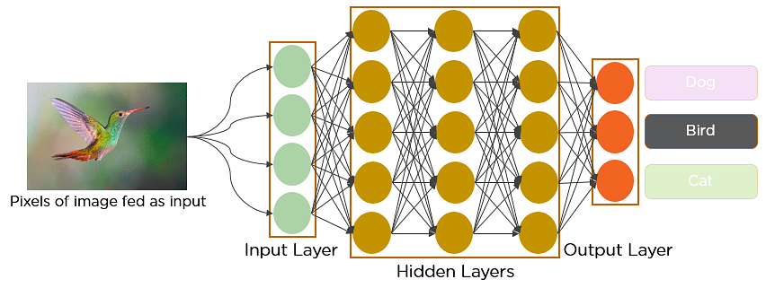
Convolutional Neural Network

Slide 14
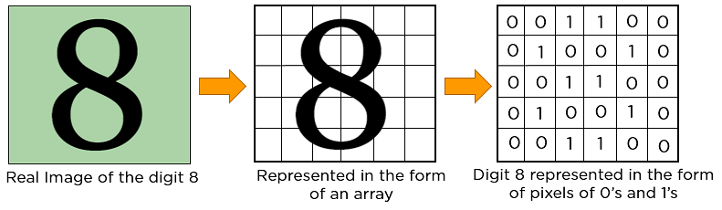
CNN - representation

Slide 15
Convolution Layer

Slide 17
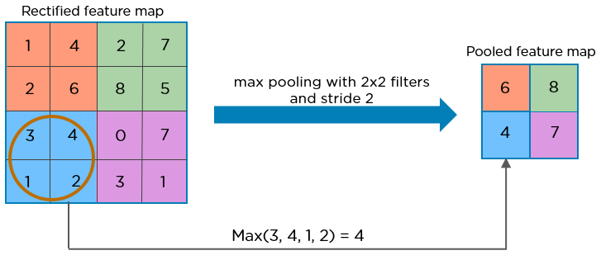
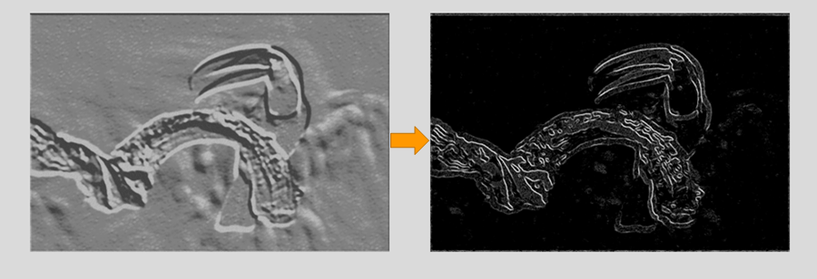
Pooling Layer

Slide 18
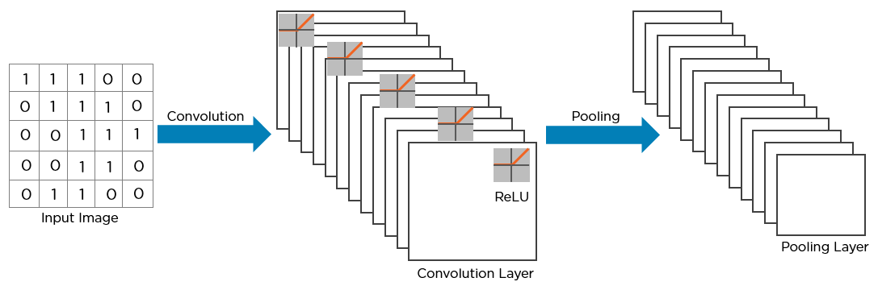
Convolution neural network

Slide 19
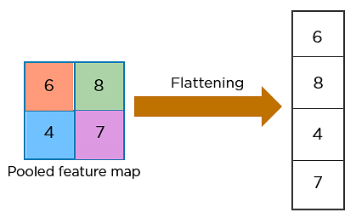
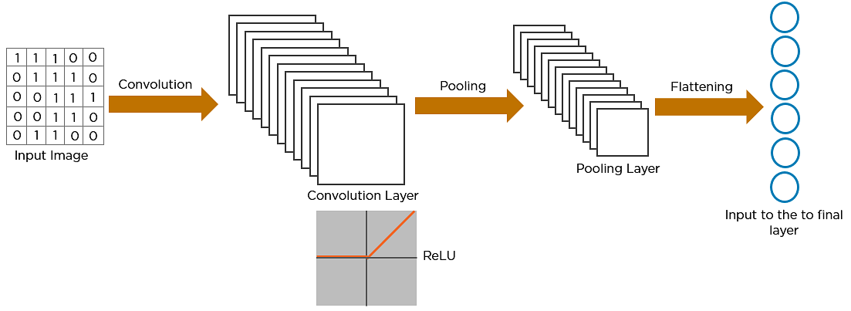
Convolution neural network

Slide 20
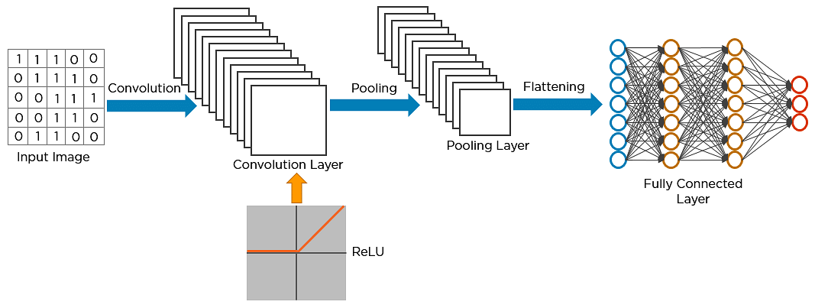
Fully connected layer

Slide 21
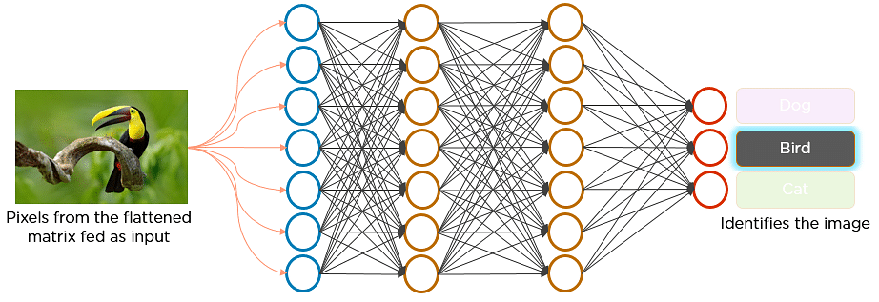
Convolution neural network

Slide 22
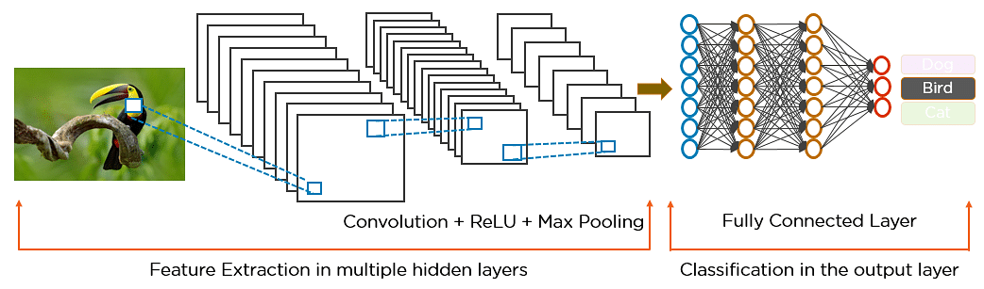
Convolution neural network

Slide 23
THANK YOU

